Slide 1


Academic Year:2022-2023/Sem-II
A self learning activity.
Second Year/ Computer Engineering /
A division.
Batch:AS1.
Subject : Database Management System.
Guided By: Prof.P.Saiprasad.

Slide 2

Group Members:
Roll No. | Name
05 | Shravani Akolkar
16 | Samiksha Bhalerao.
17 | Yashodeep Bhamare.
18 | Nikita Bhawar.
19 | Saili Bhinganiya.

Slide 3
Table Of Contents:
Sr.No. | Contents
1. | About the course.
2. | Imposing schema on a schema less system.
3. | Indexes-The keys to speed.
4. | CRUD.
5. | Administration of your database.
6. | Conclusion
7. | References.

Slide 4

About The Course:
Name Of The Course:Learning MongoDB Schema, Indexes and Queries.
Instructor:Micheal Shallop
-It possible to store and process large sets of data in ways that increase business value.
-The flexibility of unstructured, schema-less, storage, combined with robust querying and post-processing functionality, make MongoDB a compelling solution for enterprise big data needs. We need to discuss database schemas. Yes, MongoDB is touted as schema-less but here's where we show that proper design is what allows our collections to scale. Indexing is something everyone talks about, but few understand.
-The course browse MongoDB indexing, and index properties as a successful indexing strategy is a key to performance and scaling. It is also talks about CRUD commands from the MongoDB client and how to write effective queries. Taking this course helps you to understand supported standards and data types in MongoDB, and best practices to design collections to scale and index them. Also, you will learn some basic CRUD commands.

Slide 5
What is MongoDB
5

Slide 6
MongoDB is the most popular NoSQL database.
It is categorized under the NoSQL (Not only SQL) database because the storage and retrieval of data in the MongoDB are not in the form of tables.
It is open source document oriented database.
It stores data in a type of JSON format called BSON.
MongoDB stores data records as document which are gathered together in collections.
A database stores one or more collections of documents.
Features of mongoDB:-
Aggregation: It allows to perform operations on the grouped data and get a single result or computed result.
Indexing: In MongoDB database, every field in the documents is indexed with primary and secondary indices this makes easier and takes less time to get or search data from the pool of the data.
Schema-less. MongoDB is a schema-less database, which means the database can manage data without the need for a blueprint.
Document. Data in MongoDB is stored in documents with key-value pairs instead of rows and columns, which makes the data more flexible when compared to SQL databases

Slide 7
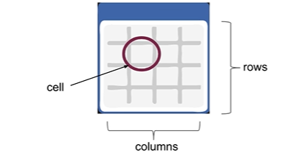
Imposing schema on a schema-less system:
What is a database schema?
-Schema is a term used to define a structure , or a format , that is applied on a relational table.
-It also defines the columns and data-types for a table.
-Schema serves to maintain table integrity by preventing the insertion of data of an incorrect data-type to a known column, or by adding data to an column in a table.

Slide 8
When you define a database schema , you’re creating a data “dictionary” for a table by:
-Defining table names of the columns.
-Defining the type of data that can be stored in a particular column.
Once the schema has been established for a table , the database engine enforces the schema by:
-Preventing you from accessing any column that is defines.
-preventing you from inserting data that is the wrong type for a column.
By enforcing schema on a table , the RDB engine maintains data integrity on the table. queries that do not conform to schema are rejected and not allowed to modify data.
Schema requires maintenance:
If you add a new column or change a column type in a RDB you will have to
Write the SQL to make a change.
Stop all applications from accessing your database.
Apply the change(execute the SQL)
Change the application code.
Test the changes.
Change any dependent RBD objects such as views , stored procedures, etc.
You will have to do this each n every time you make a change to your table schema.

Slide 9
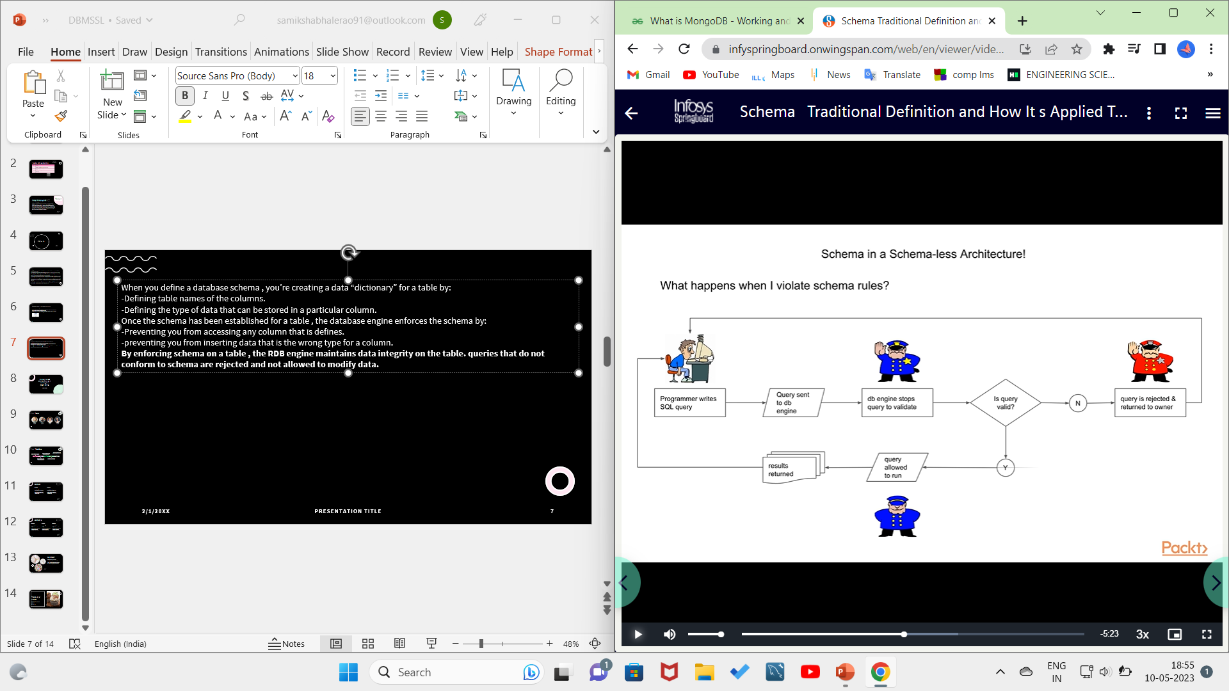
Difference between MongoDB and relational database schema:
1.Records in MongoDB are stored in collection.
2.Records in a collection are also referred to as documents.
3.Data fields and types can change during run-time.
4.Information specific to a single entity can be added without affecting any other record in the same collection.
5.Queries can search for data on the “new column” without causing an error.

Slide 10
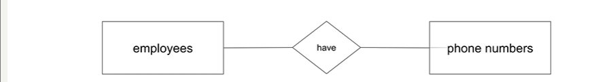
Mongo is a schema less by design which means
You can create new columns in real-time via your application and insert data .
You can mix data types within a column.
Denormalization defined as a corollary to data normalization:
What is Normalization?
-Normalization is a process of organizing data into multiple tables so as to avoid data redundancy and to store logical data in the same table.
-In traditional databases , we normalize data by breaking out data into two tables , this process establishes , or creates , a relationship between two entities.
These relationship are documented in something called a “entity-relationship” diagram:
-Relationships introduce the concepts of primary keys and foreign keys . Where the primary key in one table is the foreign key (reference) of another and entities are joined (related) via their keys.

Slide 11
Records in MongoDB are stored in collections .
Records in a collection are also referred as “documents”.
Data redundancy is encouraged under the premise that storage is cheap; CPU cycles are not.
All of the data about an entity is stored in one record meaning that all the data about an entity can be retrieved in one query.
Data types can change and should be handled at the application level.
Example of MongoDB record:
({
Id:1,
name:[{“fname”;”as1”},
{“lname”:”as1grp”}],
Phone:7498535388
});
Hence we can conclude that:
MongoDB is schema less:
You can add new data (columns) to a record that doesn’t appear in any other record.
MongoDB is not normalized:
All data from a table can be fetched in a single query without additional work!

Slide 12
MongoDB Data Type
12

Slide 13
What is data type?
-defines kind of values that are stored in a database column.
Why they are important?
-defines a range of operations that can be performed on a data object.
-impacts the efficiency of your data storage and the overall performance of your database.
Types of data type :
Integer:
-Integer is a data type that is used for storing a numerical value, i.e., integers as you can save in other programming languages. 32 bit or 64-bit integers are supported, which depends on the server.
db.collection_name.insert({“Roll_No”:19})
String:
String is one of the most frequently implemented data type for storing the data.
db.collection_name.insert({“Name”:”Saili”})

Slide 14
Boolean:
Boolean is implemented for storing a Boolean value( i.e. True Or False)
db.collection_name.insert({“Appeared For Test”:True})
Double:
Double is implemented for storing floating point data in MongoDB
db.collection_name.insert({“Marks”:89.65})
Null:
Null is implemented for storing a Null value.
db.collection_name.insert({“Email ID”:NULL})
Date:
Date data type stores date.
Date is implemented for storing the current date and time as UNIX-time format.
ObjectID :
MongoDB automatically inserts a field as “_id” into every document.
This field is called as the objectID and acts as the primary key for the collection.
Eg:-
_id: ObjectId("646a2f76ed7d13f38e3a9acb"),

Slide 15
Indexes
-Take an example of a book which has a index followed by a page number on which the term appears. You would simply look up in the word in the index and then turn to the page containing that word. In this analogy the book is our database collection and each page is a record. The search term or a look up word would be a column value.
- Searching means that you are asking the database to locate a specific record based on a qualifying piece of information.
-A database search is based on indexing.
-MongoDB indexes store a portion of the record in a structure that quickly , and easily Searched. The index stores the values of the specific field and that data is ordered by the value of the field in order to support equality and range based search matching.
-MongoDB indexes are differentiated by their type and , in turn , possess properties.

Slide 16
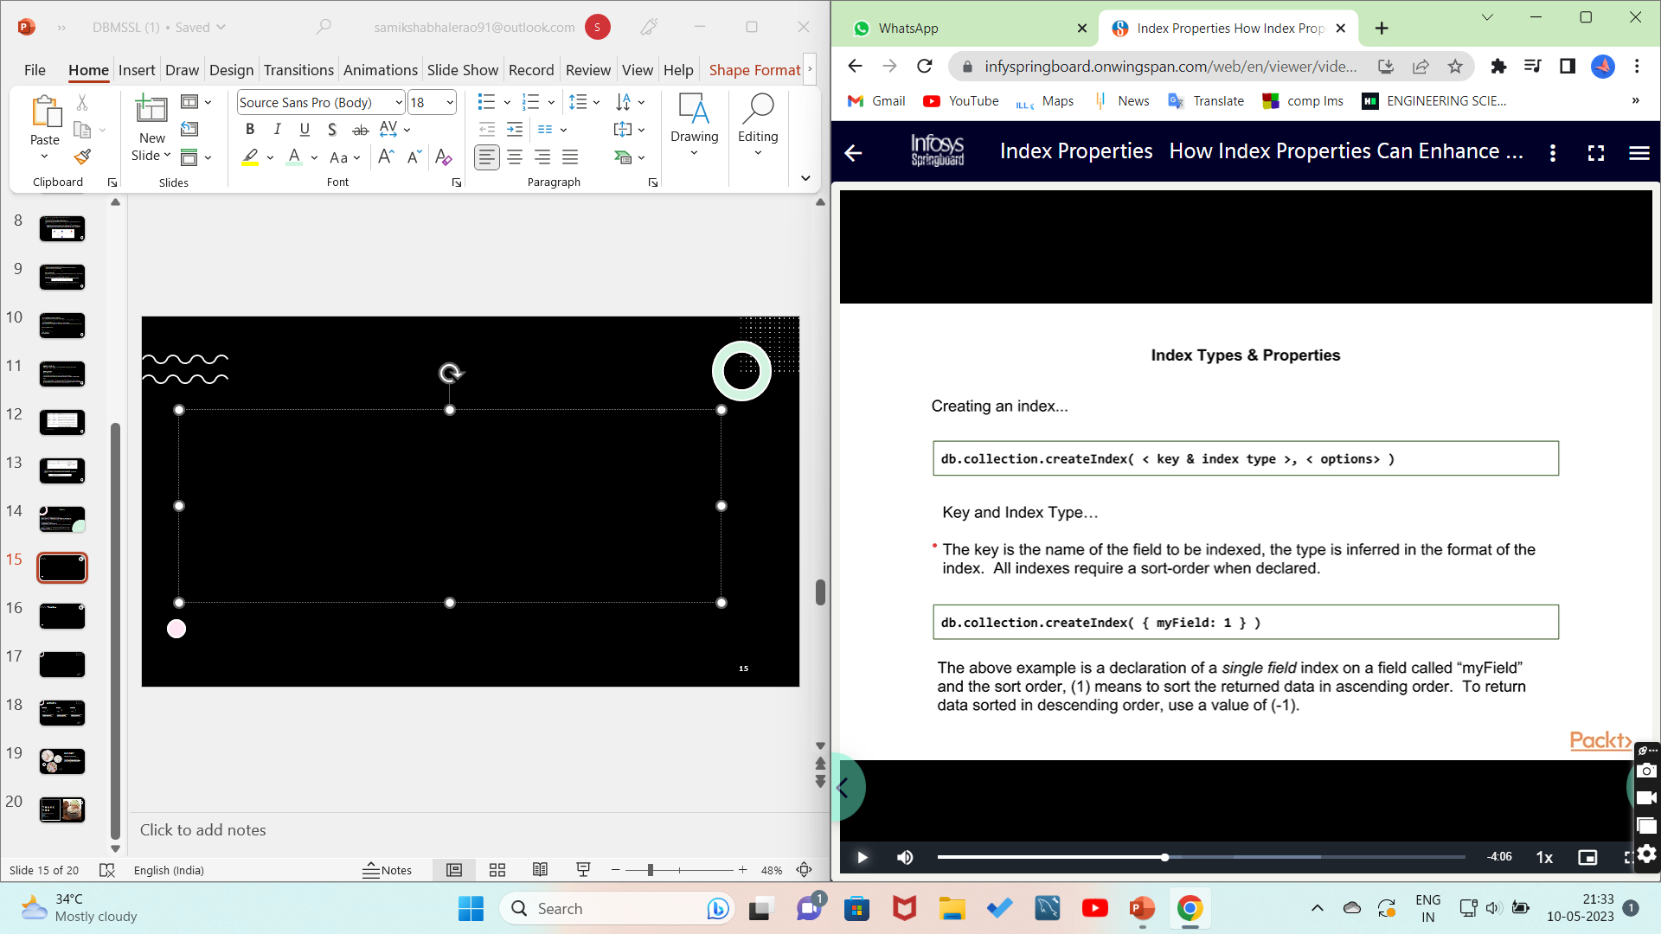
Creating an Index :
To create a index mongoDB provides a method called createIndex().
Syntax:
db.COLLECTION_NAME.createIndex({KEY:1})
Example:
db.student.createIndex({ name:1})
Key and index type:
-The key is the name of the field to be indexed , the type is inferred in the format of the index.
-All indexes require a sort-order when declared.
-The above example is a declaration of a single field index on a field called “myField” and the sort order ,(1) means to sort the returned data in ascending order .To return the data in descending order , use a value of (-1).

Slide 17
The dropIndex( ) Method
In order to drop an index, MongoDB provides the dropIndex() method.
Syntax:
db.COLLECTION_NAME.dropIndex({KEY:1})
Example:
Db.student.dropIndex({“mobile”})
The getIndexes() Method:
The getIndexes() method in MongoDB gives a description of all the indexes that exists in the given collection.
Syntax:
db.COLLECTION_NAME.getIndexes()
Example:
db.student.getIndexes()

Slide 18
CRUD Operations
CRUD stands for:
Create: Databases or records are created.
Read: Data is accessed from store.
Update: Existing data is altered.
Delete: Databases are deleted.
MongoDB shell is an interactive JavaScript interface to MongoDB.
The shell gets invoked by typing the command : ”mongo”.
The mongo shell allows you to perform administrative tasks as well as issue commands directly to database engine.

Slide 19
The CREATE command
Things you can create using the mongo shell…
Databases
Collections
Records
Indexes
Users
Roles
Syntax: use newDatabase
Example: use samiksha;
The db , if it did not existed previously ,will be created when you explicitly create a collection , or when you store data into your database.

Slide 20
Creating a document:
({
name:”cake”,
flavour:”vanilla”,
price:200,
ratings:4.5
});
Mongo record creation uses the word “insert”
-insert()
-insertOne()
-insertMany()
Key points:
-If the inserted document is missing the _id field , the mangoDB driver will automatically
Generate an ObjectId(type) for the _id field.
-The atomicity of an insert operation is the single document.

Slide 21
insertOne():
db.products.insertOne({name:"cake",flavour:"cream n cookie",price:800,ratings:5});
insertMany():
db.products.insertMany([{name:"pastry",flavour:"butterscotch",price:80,ratings:4.8},{name:"pastry",flavour:"mango",price:50,ratings:4.2}]);

Slide 22
The FIND Command
There are 2 methods to find and select data from a MongoDB collection, find() and findOne().
find()
To select data from a collection in MongoDB, we can use the find() method.
This method accepts a query object. If left empty, all documents will be returned.
Example: db.posts.find()
findOne()
To select only one document, we can use the findOne() method.
This method accepts a query object. If left empty, it will return the first document it finds.
Note: This method only returns the first match it finds.
Example: db.products.find();

Slide 23
Few more examples:
db.products.findOne();
We use a 1 to include a field and 0 to exclude a field.
Example
This time, let's exclude the _id field.
db.products.find({},{_id:0,name:"pastry"});

Slide 24
The UPDATE Command
Update Document
To update an existing document we can use the updateOne() or updateMany() methods.
The first parameter is a query object to define which document or documents should be updated.
The second parameter is an object defining the updated data.
updateOne()
The updateOne() method will update the first document that is found matching the provided query.
the "like" count for the post with the title of "Post Title 1":
Example:

Slide 25
Example
db.products.updateOne({name:"cheesecake"},{$set:{flavour:"choco lava",price:750},$currentDate:{lastModified:true}})
updateMany()
The updateMany() method will update all documents that match the provided query.
Example:
db.products.updateMany({ratings:5},{$set:{reviews:"Best"}});

Slide 26
The DELETE Command.
We can delete documents by using the methods deleteOne() or deleteMany().
These methods accept a query object. The matching documents will be deleted.
deleteOne()
The deleteOne() method will delete the first document that matches the query provided.
Example
db.products.deleteOne({name:"cake",flavour:"vanilla"});
deleteMany()
The deleteMany() method will delete all documents that match the query provided.
Example
db.products.deleteMany({name:"cheesecake"});

Slide 27
Aggregation
Aggregation in MongoDB is a process wherein you group values from multiple documents together , performing a variety of operations on the data to return a single result.
MongoDB provides three ways to perform aggregation:
1)Single purpose aggregation methods.
2)Map-reduce functions.
3) Aggregation Pipeline.

Slide 28
Single-purpose aggregation Functions.
Single purpose aggregation function aggregates documents from a single collection.
count(): It returns a count of the no. of documents in a collection
Eg: Select count(*) from employee;
groupby(): The groupby separates documents into groups according to group key
Eg: Select dept from employee groupby dept;
distinct(): It displays unique values from the column and neglects duplicate values.
Eg: Select distinct (count(salary)) from employee;

Slide 29
Map-Reduce
Map-reduce is a data processing paradigm for condensing large volumes of data into useful aggregated results.
To perform map-reduce operations, MongoDB provides the mapReduce database command.
In MongoDB, map-reduce operations use custom JavaScript functions to map, or associate, values to a key.
If a key has multiple values mapped to it, the operation reduces the values for the key to a single object.
In general map-reduce is less efficient and more complex than the aggregate pipeline.

Slide 30
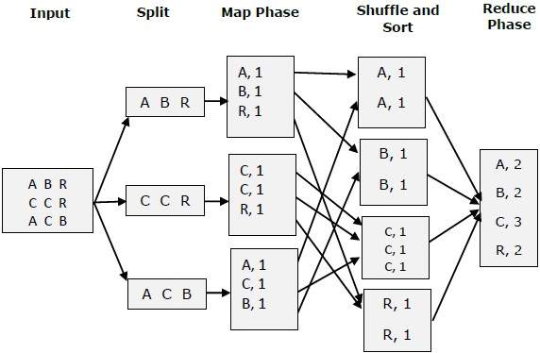
Map-Reduce

Slide 31
Aggregation Pipeline
An aggregation pipeline consists of one or more stages that process documents:
Each stage performs an operation on the input documents. For example, a stage can filter documents, group documents, and calculate values.
The documents that are output from a stage are passed to the next stage.
An aggregation pipeline can return results for groups of documents. For example, return the total, average, maximum, and minimum values.

Slide 32
Aggregation Pipeline- Example
db.orders.insertMany( [
{ _id: 0, name: "Pepperoni", size: "small", price: 19,
quantity: 10, date: ISODate( "2021-03-13T08:14:30Z" ) },
{ _id: 1, name: "Pepperoni", size: "medium", price: 20,
quantity: 20, date : ISODate( "2021-03-13T09:13:24Z" ) },
{ _id: 2, name: "Pepperoni", size: "large", price: 21,
quantity: 30, date : ISODate( "2021-03-17T09:22:12Z" ) },
{ _id: 3, name: "Cheese", size: "small", price: 12,
quantity: 15, date : ISODate( "2021-03-13T11:21:39.736Z" ) },
{ _id: 4, name: "Cheese", size: "medium", price: 13,
quantity:50, date : ISODate( "2022-01-12T21:23:13.331Z" ) },
{ _id: 5, name: "Cheese", size: "large", price: 14,
quantity: 10, date : ISODate( "2022-01-12T05:08:13Z" ) },
{ _id: 6, name: "Vegan", size: "small", price: 17,
quantity: 10, date : ISODate( "2021-01-13T05:08:13Z" ) },
{ _id: 7, name: "Vegan", size: "medium", price: 18,
quantity: 10, date : ISODate( "2021-01-13T05:10:13Z" ) }
] )

Slide 33
Aggregation Pipeline
db.orders.aggregate( [
{
$match: { size: "medium" } // filter pizza by its size
}
{
$group: { _id: "$name", totalQuantity: { $sum: "$quantity" } } // group by pizza name and total quantity
}
] )
Output :
The $match stage:
Filters the pizza order documents to pizzas with a size of medium.
Passes the remaining documents to the $group stage.
The $group stage:
Groups the remaining documents by pizza name.
Uses $sum to calculate the total order quantity for each pizza name. The total is stored in the totalQuantity field returned by the aggregation pipeline.
[
{ _id: 'Cheese', totalQuantity: 50 },
{ _id: 'Vegan', totalQuantity: 10 },
{ _id: 'Pepperoni', totalQuantity: 20 }
]

Slide 34
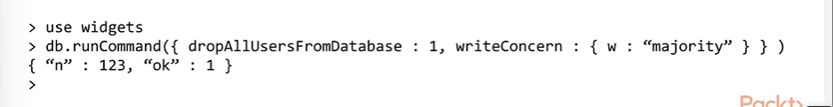
Administration of your database
Dropping Databases and Collections:
db.dropDatabase()
It drops the database and deletes the associated files.
Dropping a database generates a global write lock – all other operations will be blocked until completion of the delete request.
Note: This command does not drop any users associated with the database!
For a example:

Slide 35
To drop a collection from a database , use the drop command:
db.<collection>.drop()
Removes a collection from the database.
The method also removes any indexes associated with the dropped collection.
Returns :
true when successfully drops a collection.
false when collection to drop does not exist.
db.collection.drop() obtains an exclusive lock on the specified collection for the duration of the operation. All subsequent operations on the collection must wait until db.collection.drop()releases the lock.

Slide 36


